Slide 1
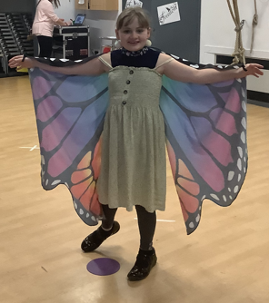
LOSELEY FIELDS
PRIMARY SCHOOL
NEWSLETTER
MARCH 2024
A word from the Headteacher
For this month’s newsletter I would like to focus on the performing arts curriculum that our children have been experiencing over the last few weeks; it is both rich and varied. The importance of giving our children a rich range of cultural experiences not only improves their knowledge of the world around them but also improves vocabulary which supports literacy outcomes but also ignites that important spark in learning, opens their eyes to other ways people live and most importantly makes memories that the children will take with them into the next stage of their development.
Every year we work with DELIGHT CHARITY across the school in various year groups. Delight is a leading arts-based learning charity, dedicated to creating lasting change for children affected by disadvantage. Our vision is to provide equal opportunity for every child to thrive both in their school years and beyond. In Year 2 we participate through their @Delight in the Woods’ programme in Year 3 & 4 we participate in ‘Delight at Watts’ and in Year 5 we undertake ‘Delight in Shakespeare’. Delight in Shakespeare develops children’s enthusiasm for drama, storytelling and heritage text and ensures they have a strong foundation in Shakespeare before moving on to secondary school. The programme begins with an interactive professional performance by Guildford Shakespeare Company, children work with professional actors and their teacher to develop a range of theatrical skills, use Shakespearean language, and design sets, props and costumes.
This week I had the pleasure in sharing in a piece of work that Year 5 have been working on across the last half term. SHAKESPEARE came to Loseley in full costume and the school and parents thoroughly enjoyed the children’s performance of THE TEMPEST the children have been working on with their teacher Miss McCann. They did the most amazing job of not only sharing their interpretation of this text through drama but to also use this to inspire their creative writing in class. Well done, Year 5 – you did the most awesome job!
Over the last few weeks, I have also had the pleasure of watching our Year 3 & 4 children rehearsing for their performance of their forthcoming Opera, Mozart's ‘The Magic Flute’. In music lessons in Year 3 and 4 this term, the children have been taking part in a scheme provided by The Royal Opera House. They have learnt all about the opera and been given a better understanding of how opera can be accessible to all. The lessons have unlocked their imagination and creativity and they have worked hard to learn six songs from Mozart’s ‘The Magic Flute’, as well as adding expression and dramatisation to the pieces leading up to performances to the rest of the school, friends and family. We hope our families enjoy the performance!
Wishing you all a very happy (and hopefully warm and dry) Easter break.
Kind regards,
Amanda Pedder - Headteacher
Our Values - Pupil achievement
Special Headteacher Awards for March
For INTEGRITY: Sam B Y6 - for continuing to work hard after his literacy lesson because he so so engaged in writing his story – your writing was gripping Sam!
For ASPIRATION: Sophie L Y5 – for making a fantastic contribution to the Tempest
Production
For COMPASSION: Alice L Y4 – for a characterful and emotional performance of the
opera

Slide 2
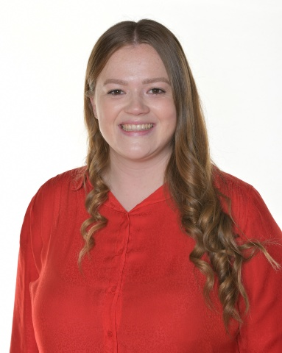
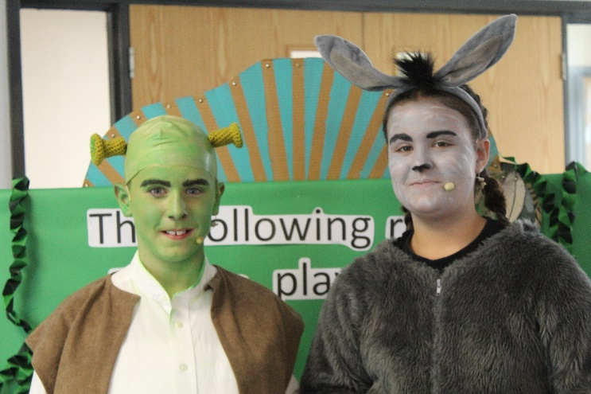
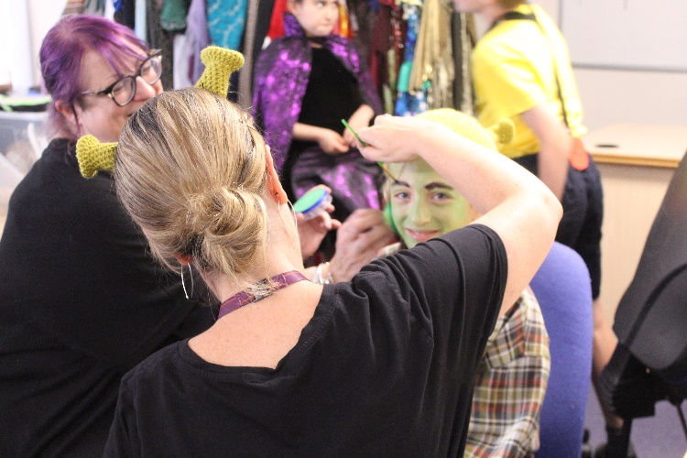
March, 2024
Upcoming Whole school events
Meet the Leader:
Gemma Brock
Hello, my name is Gemma Brock and I am the Performing Arts lead at Loseley. While it's really easy to perceive performing arts as just singing, dancing, or acting, it goes beyond the surface, revealing an excellent opportunity for children to develop a network of skills.
World Book Day – 7th March
Red Nose Day – 15th March
Y5 Residential – 18th – 20th March
Term dates
Performing arts is a gateway to unlocking a child’s creativity, nurturing their self-esteem and developing their confidence.
My role at Loseley is all about imbedding performing throughout our children’s curriculum in order to give them a wide range of opportunities. Last year we saw the comeback of our fantastic class assemblies, which enables the children to show everyone at home their amazing learning in a creative manner. Each year group across the school also has their own performance opportunity in order to allow them to build skills over time: Reception, Year 1 and Year 2 have the KS1 Nativity; Year 3 and 4 have their upcoming Opera; Year 5 participate in a Delight in Shakespeare project and Year 6 have their Summer production (this year performing ‘Matilda the Musical Jr’).
As a school, we also use drama, music and expression in a range of other lessons throughout the curriculum to inspire the children’s learning, particularly their writing. Through creativity the children can present the world from a different angle and transport audiences to magical places.
Something exciting we have on the horizon is the development of our performance space within our school hall. The Friends kindly donated money last year for us to purchase more staging and during the Easter holidays we are having a full new lighting, sound and AV system fitted, ready to use in our summer production.
End of Term – 28th March 1pm
Follow us
Loseley Fields
Primary School
@LoseleyFields
@loseleyfields

Slide 3
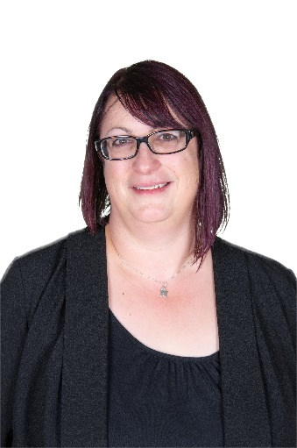
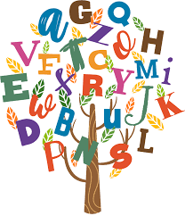
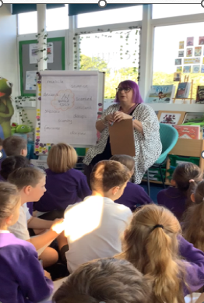
March, 2024
Update from the Leader:
Philippa leah
SPELLING HOMEWORK
New ‘help your child with their spelling homework’ video launched!
Back in October I wrote an article for the newsletter to explain the new spelling programme that we have introduced into KS2 (Year 3-6). As leader, part of my role is to monitor how the implementation of this is going and how much the children are benefiting from it. Part of this monitoring role is to look at the children’s literacy books across the school to see how the children are applying the spellings they have been learning in school and at home into their creative writing. It is this transferal from the spelling lesson into their writing which is a critical test in the success of the programme. The teachers demonstrate this to the children in literacy lessons when they lead shared writing sessions. Have you noticed if your children are using their taught spellings when they write at home?
This month, we invited our Governors into school to observe the teaching of the spelling lessons across Year 3-6. The feedback was fantastic, and they said that it would be helpful for parents to perhaps understand more fully how they can support at home. As a result, I have recorded a short film as a guide for how you support your child at home more effectively. This video can be found on our school website but if you follow this link, it will take you straight there. I hope this helps you get involved!
https://www.loseleyfields.com/our-curriculum/curriculum-subjects/power-of-reading/spelling/
Follow us
Loseley Fields
Primary School
@LoseleyFields
@loseleyfields

