Slide 1
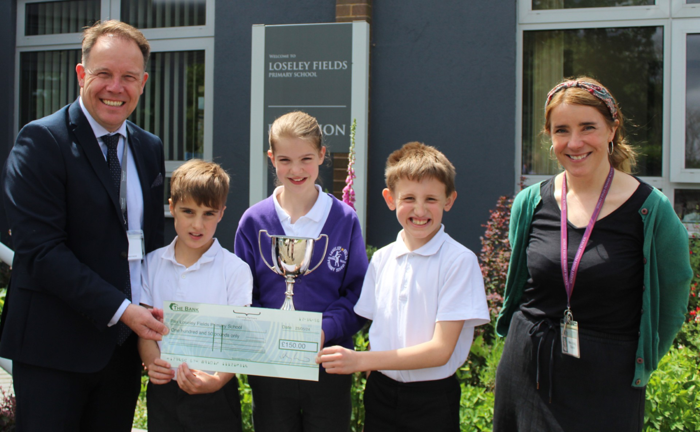
LOSELEY FIELDS
PRIMARY SCHOOL
NEWSLETTER
May, 2024
A word from the Headteacher
It has been an extremely busy last few weeks here at school. The exam season brings with it great trepidation but also many reasons to celebrate. Our fantastic Year 6 pupils successfully completed their end of primary SATs tests. I was so proud of them all. They have worked unbelievably hard this year and as a result they were able to tackle their tests with maturity. Many thanks must go to the Year 6 teaching team for working so hard to prepare them with the right balance of diligence but without placing too much stress on the children. We look forward to seeing how well they have done when the results come into the school in July. Coming across the month of June are the other statutory assessments that need to be completed which includes the Year 1 phonics screen check and the Year 4 Multiplication Check.
On a lighter note, this is also the season of school trips, music and drama. We are particularly all excited about the rehearsals for this year’s end of year production to kick start. Miss Brock has now completed auditions and parts have been allocated. I cannot wait to hear the music of Matilda The Musical, flood the school corridors during this term.
This month has seen us continue to work actively towards our sustainability goals. Our wonderful Mrs Davis has supported our children in winning an international competition hosted by Imperial College London and this week our Trust CEO, Jack Mayhew, came to school to present the children with a cheque for £150 to celebrate their success. The children plan to use this money to buy a night camera so that we can watch our site come to life with wildlife at night. Over the summer we will be having solar panels fitted to the school roof to help reduce the cost of our energy consumption but also to support us in meeting our sustainability commitments. We look forward to benefiting from this over the years to come.
I am delighted to be able to share with you an update on The Farncombe Partnership of Schools following the last few months working on the project. Mr Bibby and I have been able to spend a small amount of time meeting the staff, parents and children of Francombe Infants over the last few weeks, working with them to begin to organise staffing for September. For Loseley, we have all our staff structures in place. I am delighted to announce that we have successfully employed two Assistant Headteachers who will be joining our leadership team and working very closely with Mrs Johnson and myself over the next two years to continue to drive forward the success of our school. Mrs Kelly Day has been promoted into role and will be working on teaching and learning areas of school improvement; she will be joined by Taymar Scudamore who will be joining us from a school outside our Trust and will have responsibility for the Early Years.
Over the last few weeks, we have had a few situations where staff have had to speak with parents who are behaving aggressively in their presentation. We respectfully request that parents treat staff with respect at all times. We are always happy to hear any concerns that you have but we are best able to resolve such situations if we work together in the best interest of the children who we all care very much about. Your support with upholding our school values is appreciated.
Kind regards, Amanda Pedder - Headteacher
Our Values - Pupil achievement
Last week we enjoyed a whole school assembly celebrating children who have stood out for demonstrating our school values through their work, their play and when out and about in the community. It was lovely to see so many children nominated, and I hope that you enjoyed sharing in your children’s successes when they shared their postcards with you at home.
I was particularly proud to congratulate our girls and boys cricket teams who
represented us so proudly in a local tournament. Well done for demonstrating our values
beyond our school gates.

Slide 2
MAY, 2024
Upcoming Whole school events
Meet the SAFEGUARDING TEAM:
We have a team responsible for safeguarding at Loseley who are all trained as Designated Safeguarding Leads. Mrs Pedder is our DSL and works alongside her Deputy DSLs Faye Johnstone (Deputy Headteacher), Joe Bibby (Deputy Headteacher), Emma Baker (SENDCo) and Debbie Loveland (HSLW). For more information about their role, please see the Safeguarding and Child Protection Policy on the school’s website.
This term, we have been doing some safeguarding themed assemblies with the children from reminding them about the coloured lanyards we use for visitors through to trusted adults and the grown ups responsible for safeguarding in the school.
We have also booked Sharon Girling, an eSafety expert, to do some work with the children, staff, parents and carers in the Autumn Term. She will be exploring important topics like smart phones and how children can risk assess content online. We will send out more information closer to the time.
As we plan for the year ahead, we will be training our new Assistant Headteachers to be able to join the safeguarding team and I will move back into the DSL role from September.
Please do contact any member of the safeguarding team should you need to by phone, email or in person. There is usually a member of this team on the playground at drop off and pick up.
Sports Day 18th June
School Reports 12th July
Term dates
Summer Term – 3rd June – 22nd July
19th July last day of term (Finish 1pm) 8th July Inset Day 22nd July Inset Day
Follow us
Loseley Fields
Primary School
@LoseleyFields
@loseleyfields

