Slide 1
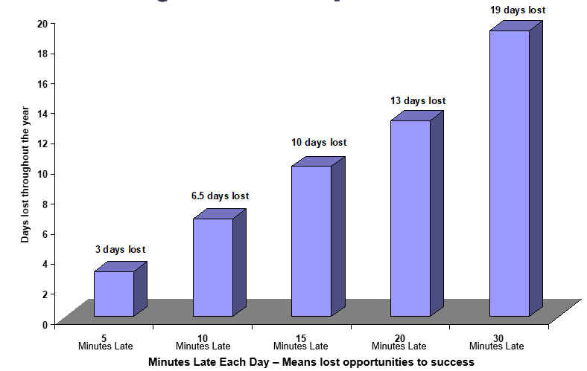
Attendance @ Loseley Fields Primary School
At Loseley Fields, we firmly believe that all pupils benefit from regular school attendance. Full and regular attendance at school is crucial for a child’s future life chances and establishes a positive work ethic early in life. Not only does good attendance guarantee no learning is missed, but children who have poor attendance do also miss out socially and on opportunities for further personal development.
It is the responsibility of the parent/carer to make sure their child attends school regularly and that they arrive punctually at school.
Every minute at school counts and children can quickly fall behind even If they have missed one day. 1 or 2 days may not seem a lot but…
Punctuality and the start of the school day
The school gates open at 8.30 for children to be able to enter the classroom at 8.40am.
The register is taken at 8.50am. Any child arriving after this time until 9.15am will be marked as late. If a child arrives after this time they will be recorded as absent.
Being late all adds up…
Good attendance | 100% | 190 days a year
Good attendance | 96% | 180 days a year 10 absences
Area of Concern – at this stage your child is categorised as a ‘Persistent Absentee’ | 90% | 171 days a year 19 days absent
Poor Attendance | 85% | 161 days a year 29 days absent
Poor Attendance | 80% | 152 days a year 38 days absent
Poor Attendance | 75% | 143 days a year 47 days absent
If your child misses… | % | Which is… | Over 13 years of schooling that is…
1 day a fortnight | 90% | 4 weeks each year | Nearly 1.5 yrs
1 day a week | 80% | 8 weeks each year | Over 2.5 years
2 days a week | 60% | 16 weeks each year | Over 5 years
3 days a week | 40% | 24 weeks each year | Nearly 8 years
Absences
There are 175 non-school days to make appointments, to go on trips and go on holidays.
Medical Appointments - Parents/carers are encouraged, whenever possible, to book medical and dental appointments outside of the school day. When appointments during school hours are unavoidable, please inform the school office with a copy of the medical appointment letter.
Family holidays - The school holiday dates are published a year in advance and are available from the school office and on the school’s website. Family holidays need to be booked within the school holiday dates. Family holidays are not deemed exceptional circumstances and will not be authorised. Please see the Fixed Penalty Notice letter that has been sent out by parent mail with regards to fines for holidays in term time.
Ways to help your child with punctuality:
Make sure all school equipment/clothes are ready the night before
Set an alarm allowing plenty of time for getting dressed and having breakfast in the morning
Contact the school if you think you are going to be running late
Check traffic and travel before leaving
If you need further support around attendance, please do not hesitate to contact our HSLW, SENCO or DHT and they can help support where they can.
Attendance is monitored regularly in school with the attendance team and each term with the Inclusion Officer. If your child has poor attendance the school and/or Local Authority’s Inclusion Officer may write to you and invite you for a meeting to discuss how you can be helped to make improvements.

